Slide 1

#1 Workshop on Alternative fuels
06-05-2026
This session will be recorded

Slide 2
Agenda
Opening – NAPCORE
  What is NAPCORE
  Update from the NAPCORE AFIR Team
European Commission – the aim of AFIR
FIER – Status of CEAP
Standards perspective / alignment
Data users perspective
Discussion
Wrap up & closing

Slide 3
NAPCORE in general
The world’s largest cooperation of mobility data platforms
NAPCORE-X is the name of the funding project to continue the operation of NAPCORE
Coordinates and harmonises all European NAPs on a technical and organisational level createing interoperability
Result: better access and re-use of EU mobility data

Slide 4
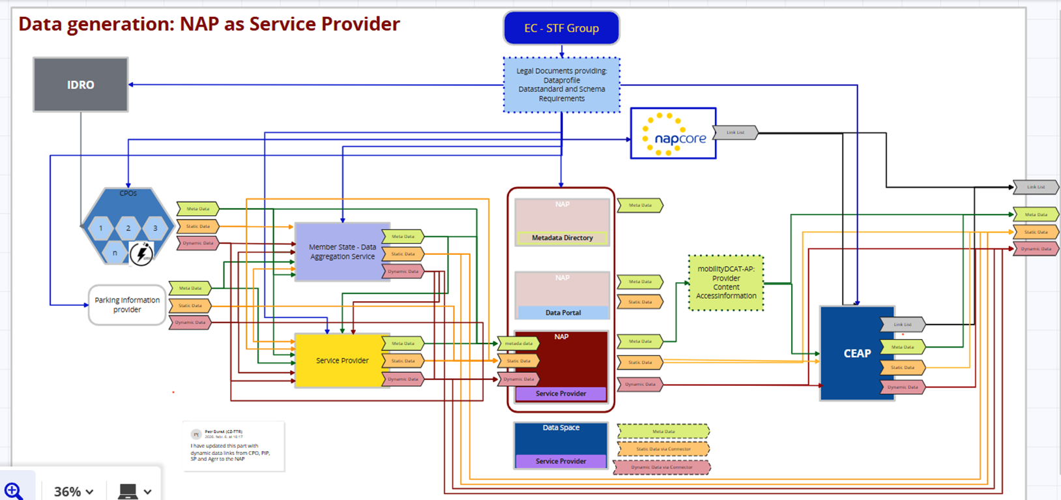
TASK 3.3 - Roadmap & Activities
A clear and consistent approach for EU Member States to implement AFIR while improving the quality, accessibility, and interoperability of AFI‑related data.
Activities
  Best Practices
  Role of the NAP
  Mediator
  Feedback loop

Slide 5
Agenda
Opening - NAPCORE
European Commission – the aim of AFIR
  The aim of AFIR
  AFIR Supporting activities
  EAFO – IDRO - CEAP
FIER – Status of CEAP
Standards perspective / alignment
Data users perspective
Discussion
Wrap up & closing

Slide 6
Agenda
Opening - NAPCORE
European Commission – the aim of AFIR
FIER – Status of CEAP
  Mockup for CEAP
  Pilot/Test connection NAP > CEAP
Standards perspective / alignment
Data users perspective
Discussion
Wrap up & closing

Slide 7
Agenda
Opening - NAPCORE
European Commission – the aim of AFIR
FIER – Status of CEAP
Standards perspective / alignment
  OCPI – EVRoaming
  DATEXII – NAPCORE
Data users perspective
Discussion
Wrap up & closing

Slide 8
Agenda
Opening - NAPCORE
European Commission – the aim of AFIR
FIER – Status of CEAP
Standards perspective / alignment
Data users perspective
  Eco-Movement
  ChargeUp Europe
  E-Mobility Europe
Discussion
Wrap up & closing

Slide 9


Open discussion / Q+A
Participants may share:
Their opinion / take on the regulation and the governance
Improvement suggestions, pain points NAPCORE should focus on in the future
Important topics to address for our next Workshop with the stakeholders and Commission
AoB

Slide 10


Wrap up & closing

Slide 11


Thank you for your attention!

